Slide 1
The Scientific Method

Slide 2
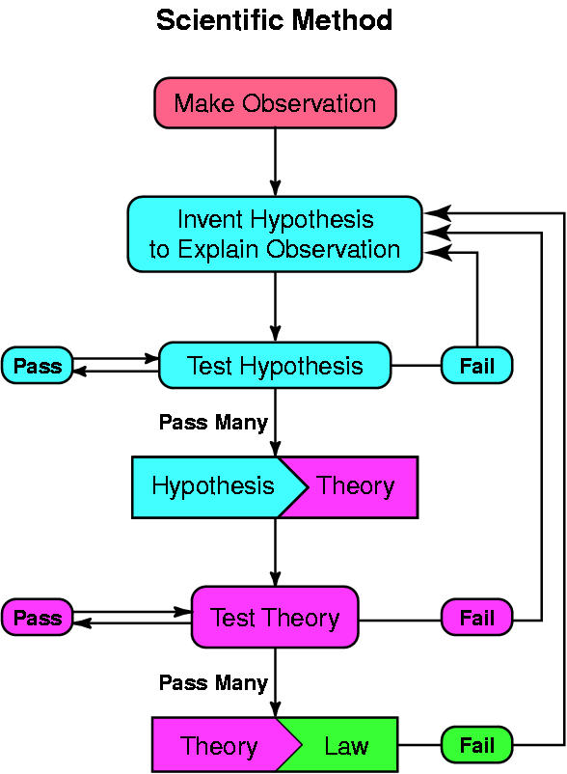
Steps in the Scientific Method
From: http://pasadena.wr.usgs.gov/office/ganderson/es10/lectures/lecture01/sci.method.jpg

Slide 3
I. The Scientific Method:
a) Definition:
A logical, stepwise approach used by scientists to find answers to questions.
b) Steps:
1. Observation: Observations are made by scientists about their surrounding environment. The observations enable the scientists to illicit questions.
2. State the Problem: The problem statement is in the form of a question. It is derived from the observations made by the scientist.

Slide 4
3. Conduct Backgound Research: Information about the problem must be researched by the scientist. This is accomplished by research journals and periodicals, textbooks, internet databases, consultation with professors, etc.
Form a Hypothesis: A hypothesis (an educated guess) is formed and stated based upon the background information acquired by the scientist. The hypothesis usually begins in the following manner:
  ….. “Based upon previous studies, it is believed that……”
5. Design and Perform an Experiment: It is essential for the scientist to accrue a list of materials and methods before the experimentation begins. In addition, it is essential that the experimenter designs the experiment in such a way that it is reproducible.

Slide 5
6. Gather, Organize, and Analyze Data: Data (information from the experiment) whether qualitative or quantitative must be accurately recorded. The data can be properly displayed in a graph, chart, table, etc. Trends and experimental significance can be determined by analyzing the data after being organized.
7. Form a Conclusion: Based upon the experimental results, conclusions can be made regarding the study.
c) Key Ideas:
All experiments must have a control and one variable group.
Experimental controls are factors to which the outcome is known. The control is a factor in an experiment that does not change. It is used as a means of comparison.

Slide 6
The variable is a newly introduced factor. The variable may result in differing data as compared to the control.
It is important to note that in an experiment, only one variable should be introduced at a time.
A theory is a generalization based on many observations and experiments; a well-tested, verified hypothesis that fits existing data and explains how processes or events are thought to occur. It is a basis for predicting future events or discoveries. Theories may be modified as new information is gained.

